Slide 1
Data Career Mapping
Carrie Chunn , Samatha Madur, Jack Grimm, Al Faust

Slide 2
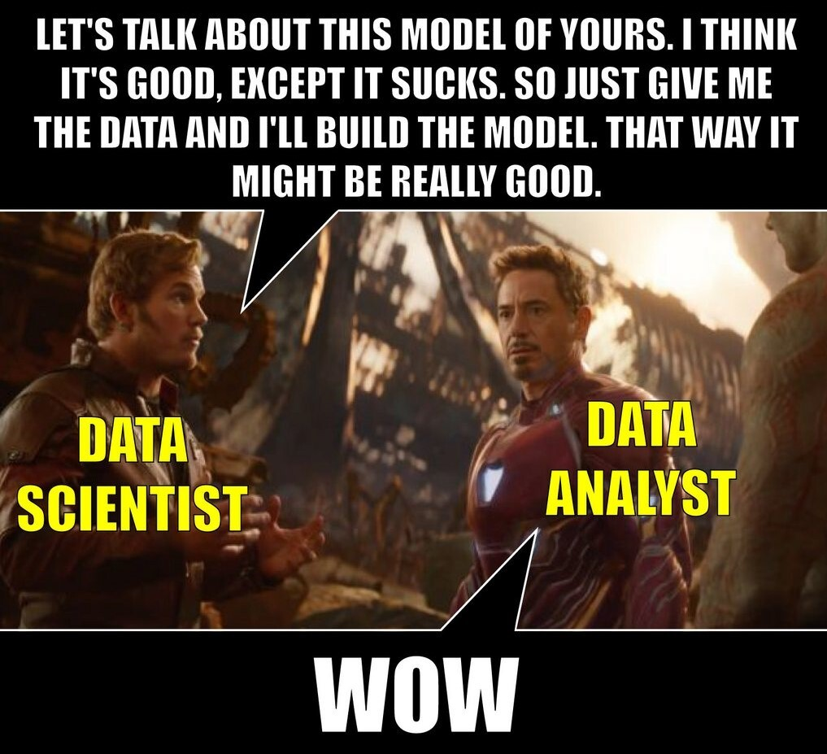
Objective
Create an interactive map showing salary comparisons between Data Analyst, Data Scientist, Data Engineers and Machine Learning Engineers from jobpostings scraped from Glassdoor.

Slide 3
Data Source & Clean-up

Slide 4
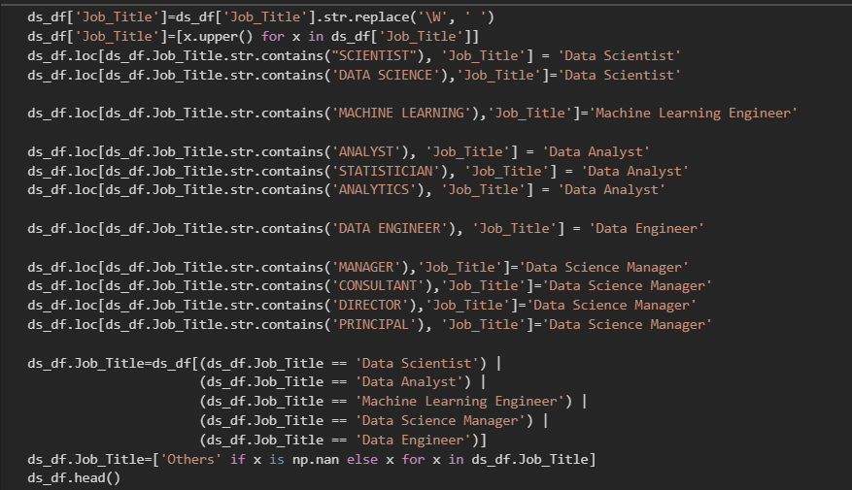
Data Source & Clean-up
Data from job postings tagged as “Data Scientist” and “Data Analyst” were scraped using selenium from Glassdoor and cleaned using Jupyter Notebook.
Total number of jobs scraped in September: 3800
Data was cleaned using Regular Expressions, scikit learn & OpenCage Geocode API
Job titles were standardized and grouped into umbrella titles
Skills were extracted from job descriptions
lat/lon were added using a separate API and utilizing the city/state information scraped from the jobs
Visualizations were created using matplotlib, seaborn and plotly packages

Slide 5
SQL Load & Analysis

Slide 6
SQL Load & Analysis
Using pgAdmin a SQL data was created to host our exported csv (refined_skills.csv). This allowed us to create two tables to use as our main data calls in our app.py
Table “refined’ contained all data imported but limited the columns to job_title, industry, state, lat, lon
Table “avg_salary” contained average salary grouped by job_title and state excluding the Others job title
Using bootstrap and the exports of graphs from our data cleanup, an index.html was created to aid in understanding. Using individual bootstrap cards, key graphs and comments are grouped together to allow us full utilization of the data gathered.

Slide 7
App.py

Slide 8
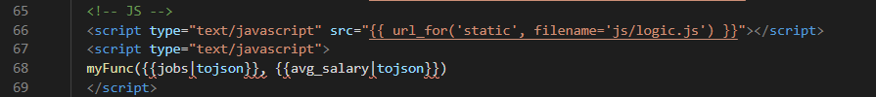
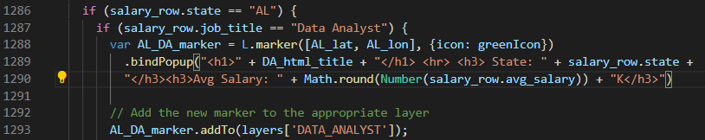
App.py
Using psycopg2 in the flask app, our SQL data was passed along to our javascript page using a local function in our map.html. This allowed us to call our refined table data as a json array to be iterated through and sorted in javascript. Using a combination of for loops and nested if statements, our data was sorted and group by state and job title, then matched with its respective average salary from our average salary table and populated using another for loop. Markers are color coordinated to help distinguish what markers belong to what job title.
Jquery and sliiide was implemented to have an easy to use menu that didn’t distract from the data being presented.

Slide 9
Demonstration

